Slide 1

COURSE PROJECT
Adithya Seesanabilu Nagaraj
Jahnavi Bollineni
Nidhishree Talastha
Prajwal Hosahalli Dayananda
Sinduja Kuna

Slide 2
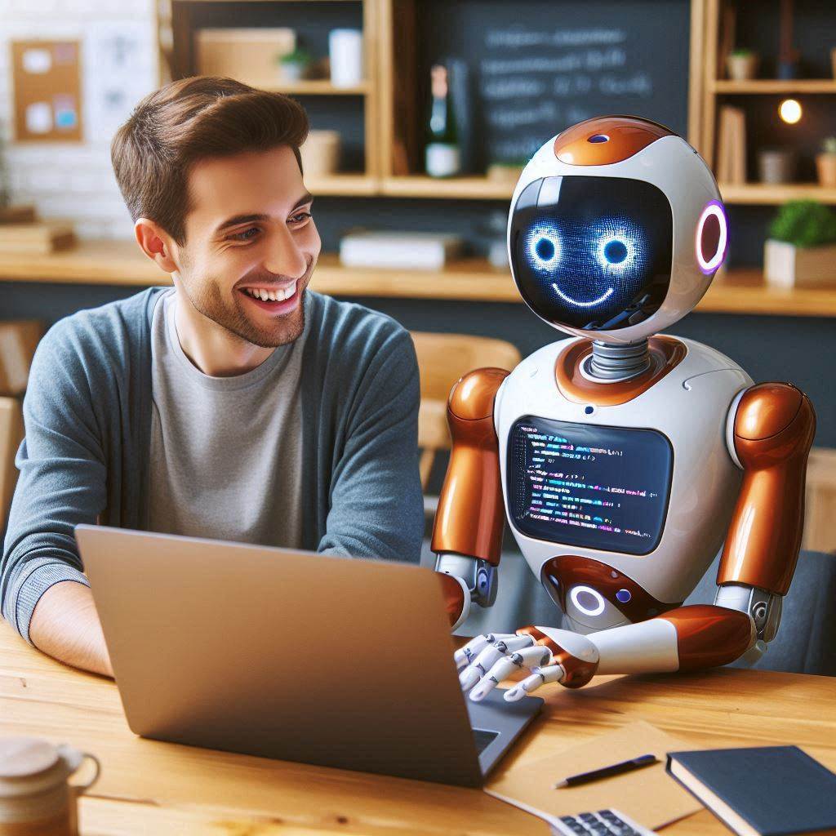
DevAssist AI : An AI Pair Programmer
An AI-powered tool that assists developers by generating code snippets, providing real-time suggestions, and detecting errors based on natural language prompts.

Slide 3


Must-Have Functional Requirements
1. As a developer, I want the AI to integrate seamlessly with my preferred IDE (e.g., VS Code), so that I can work without switching between multiple tools.​
2. As a developer, I want the AI to detect syntax and logical errors in my code, so that I can fix them quickly without having to debug everything manually.​​

Slide 4
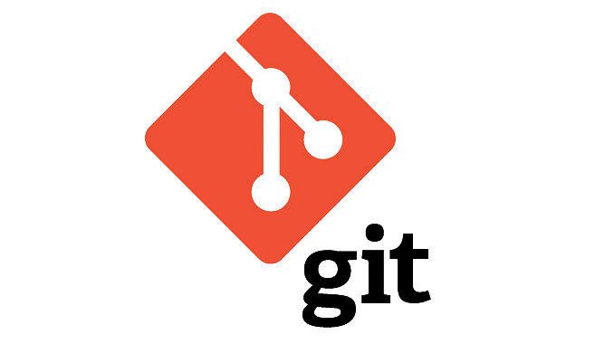




3. As a developer, I want the AI to integrate with version control systems like Git, so that I can commit, push, and resolve merge conflicts directly from my development environment.
4. As a developer, I want the AI to automatically generate docstrings and comments for my code, so that my code is better documented and easier to understand.
5. As a developer working on cloud-based projects, I want the AI to assist in deploying my code on Vercel, Hugging Face or Github pages, so that I can manage infrastructure and deployments seamlessly from within my IDE.

Slide 5
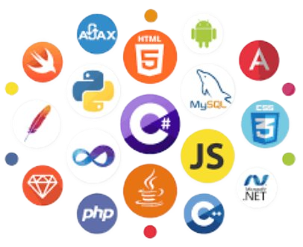
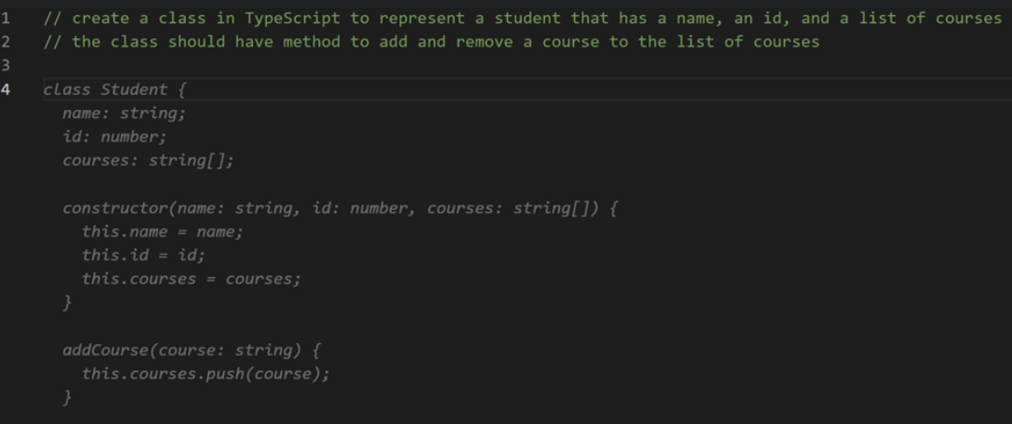

6. As a developer, I want the AI to support multiple programming languages and frameworks, so that I can work on different types of projects within the same tool.
7. As a developer, I would like to see the AI tool can automatically generate the code based on the provided comments, so that it can save the development time for the developer
8. As a developer, containerizing applications using docker should be supported, to enable seamless and consistent deployment across different environments.

Slide 6

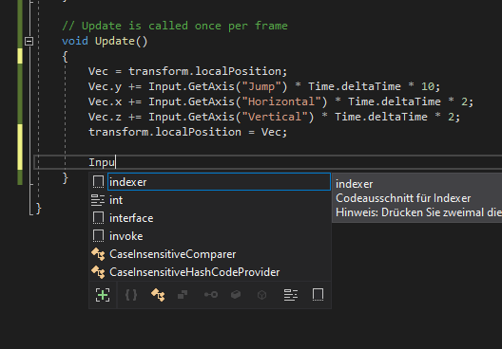

Must-Have Non-Functional Requirements
1. As a developer working on sensitive code, I want my data to be encrypted and kept secure, so that my proprietary code is protected from unauthorized access.
2. As a developer, I want the AI to provide code suggestions in real-time, so that I don't experience delays while coding.
3. As a developer, I want the AI tool to be easy to use and intuitive, so that I can focus on my work instead of learning how to operate the tool.

Slide 7



4. As a developer, I want the AI tool to have 99.9% uptime, so that I can trust it will always be available when I’m coding.
5. As a developer, I want the system to be cost-efficient in terms of cloud usage, so that I can afford to use it while keeping my budget under control.
6. As a developer, I want the system to be compatible with all operating systems and underlying platforms, ensuring cross-platform functionality.

Slide 8
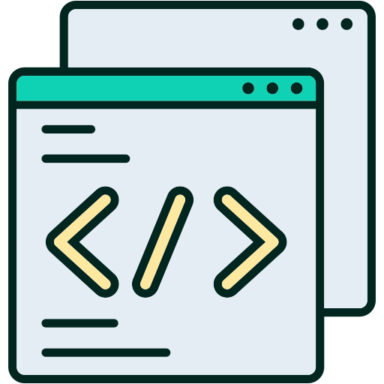
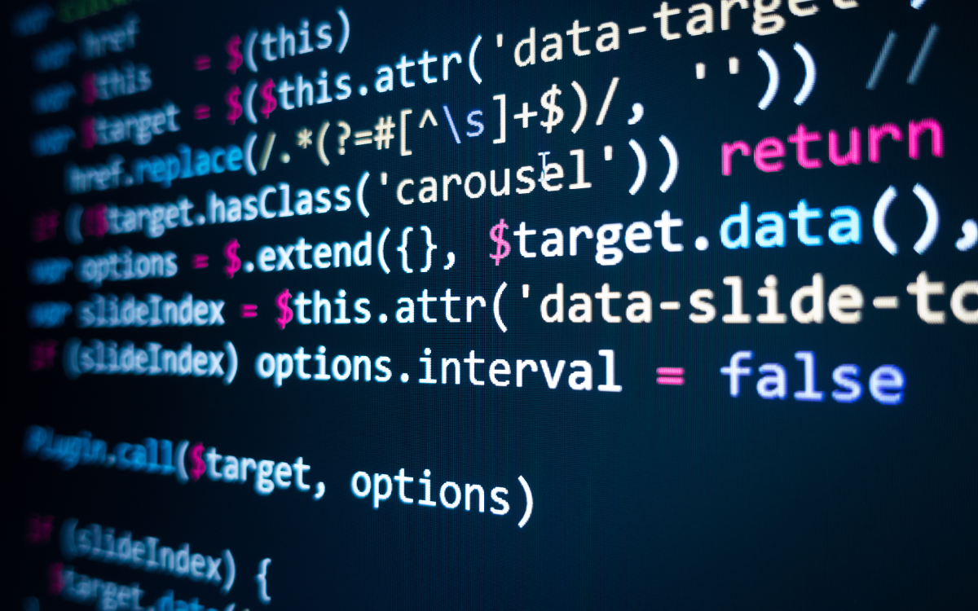
Nice to Have Requirements
1. As a developer, I want the AI to be available as a web-based tool, so that I can access it from anywhere without needing to install software.
2. As a team lead, I want the AI tool to scale and handle multiple users and large projects, so that my team can work collaboratively without performance issues.
3. As a development team lead, I want the AI system to be easily extendable, so that we can add new programming languages, features, and integrations over time.

Slide 9
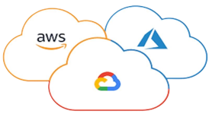
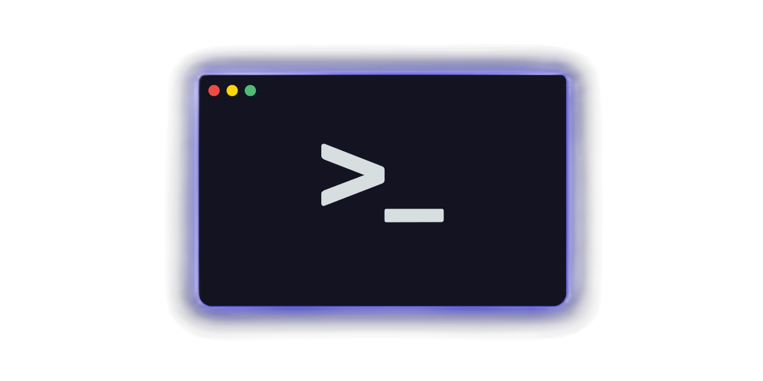
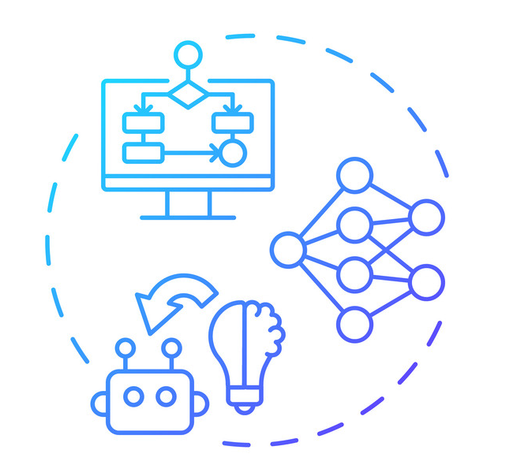
4. As a developer working on cloud-based projects, I want the AI to assist in deploying my code on AWS or GCP, so that I can manage infrastructure and deployments seamlessly from within my IDE.
5. As a developer who prefers the command line, I want the AI to be available as a CLI tool, so that I can generate and troubleshoot code directly from the terminal.
6. As a developer, I want the AI model to be periodically retrained, so that its suggestions improve and stay up to date with current programming trends.

Slide 10
Thank You

